Slide 1

Trading Data For Learning: Incentive Mechanism For On-Device Federated Learning
Rui Hu, Yanmin Gong
University of Texas at San Antonio
Notes:
Hello, everyone. My name is Rui Hu, from university of texas at san Antonio. I am going to present our work Trading Data For Learning: Incentive Mechanism For On-Device Federated Learning.

Slide 2


Huge volumes of data born at the edge…
Data enables better products and smarter services
data
machine learning
data
2
data
Notes:
In the recent years, we see an increasing number of smart devices, like smart phones, smart watches, come out and interact with our daily life.
And everyday these smart devices constantly generate a huge volumes of data…
And we all know that these data are precious because nowadays machine learning techniques enable us to leverage these data to provide better products and smarter services.
While in practice, how do we use these data with machine learning techniques? Or How to learn from the data that is born at the edge?

Slide 3
On-Device learning?
Training & Prediction on the device:
no privacy leakage
personalized model (individual opinions and habits)
But what about…
exploit new experience
benefit from peers’ data
data
data
data
Notes:
So the most intuitive way is to learn the model on-device.
In this case, everyone learns its own model on its device without moving the data to anywhere else, so that there has no privacy loss and the learned model is personalized which captures user’s own opinions or habits.
However, in this case, the user cannot exploit new experience and benefit from others’ data.

Slide 4




Gather data in the cloud?
Send data to the cloud:
privacy leakage
prediction
model
Training data
Notes:
So, to learn from more data, we can gather the data to the cloud and do training and prediction in the cloud.
So in this case, everyone first sends its data to the cloud. And then the cloud server trains a model on the collected data. After the training, the user can downloads the model for inference.
This method allows users benefit from others data. But, the privacy of users will be compromised as they need to share their raw data to the cloud.

Slide 5
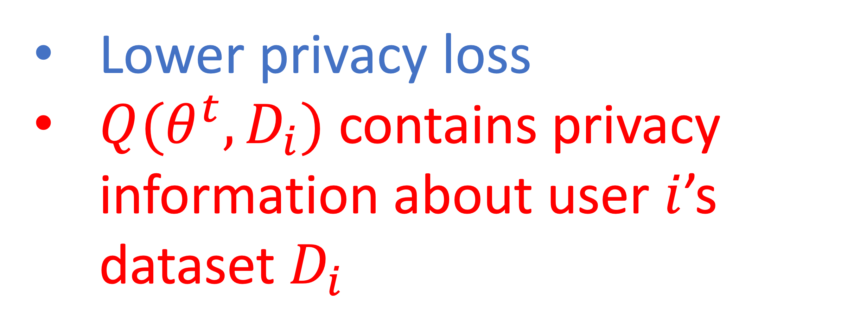
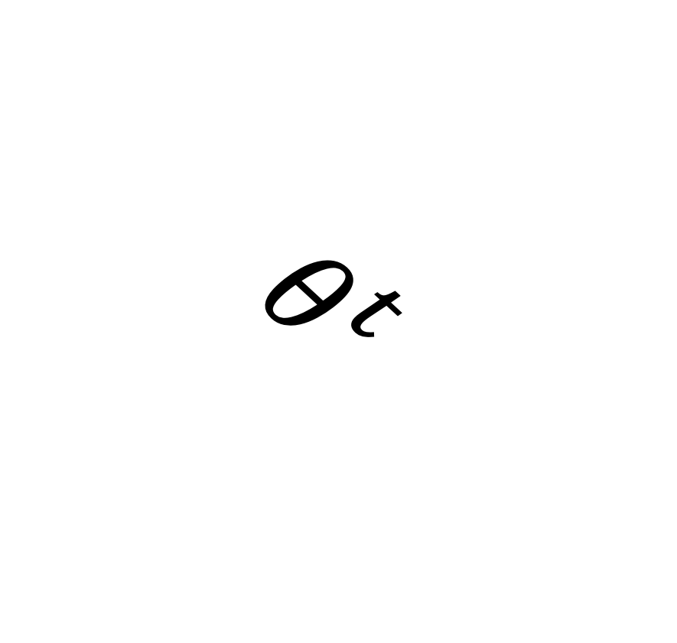
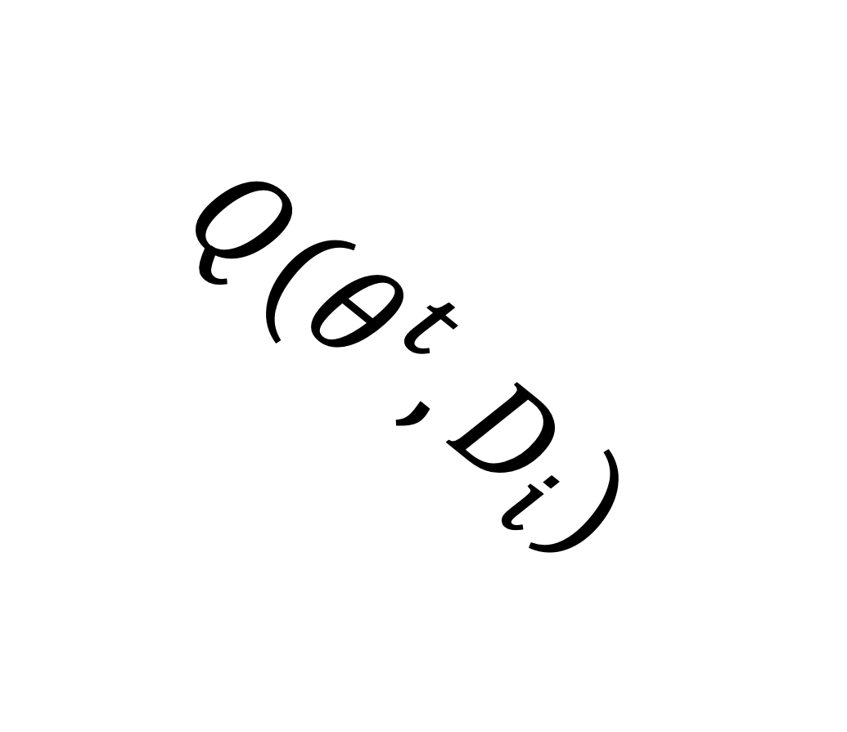

Federated Learning (FL): Keep data at the edge!
Collaboratively train a shared model:
Lower privacy loss
$Q(θ^{t}, D_{i})$ contains privacy information about user $i$’s dataset $D_{i}$
$$θ^{t}$$
$$Q(θ^{t}, D_{i})$$
$$θ^{t}$$
Local query function $Q(⋅)$, e.g., compute gradient; $θ^{t}$: model parameter at iteration $t$
Notes:
So to mitigate the privacy leakage, federated learning is proposed to allow users collaboratively train a model while keeping their data at the edge.
Basically, in federated learning, edge devices iteratively train a model under the coordinate of cloud server. At each iteration, devices download the model parameter from the server and then query local dataset, e.g., compute gradient. Next, devices send the querying results back to the server where all querying results will be aggregated to update the model parameter.
We can see that since everyone keeps their data locally, the privacy loss will be reduced. But still, the querying results contain privacy information about the local dataset.
And it’s easy for attackers to infer the raw data using membership attack or reconstruction attack.
So users still have privacy concern, which will prevent them from contributing their data in federated learning.
In this paper, we study the problem that how to motivate users to participate in FL tasks.

Slide 6
How to motivate users to participate in FL?
Monetary reward: ask users to trade their private data for FL
 | Cost | Gain
User: | privacy loss | monetary reward
Server: | total reward | trained model
Notes:
The most intuitive way is to use the monetary reward, i.e., ask users to trade their private data for federated learning tasks. In this case, users will obtain monetary reward according to their contributions, by sacrificing their privacy. For the server, it can obtain a model trained on sensitive data by paying all participants.

Slide 7
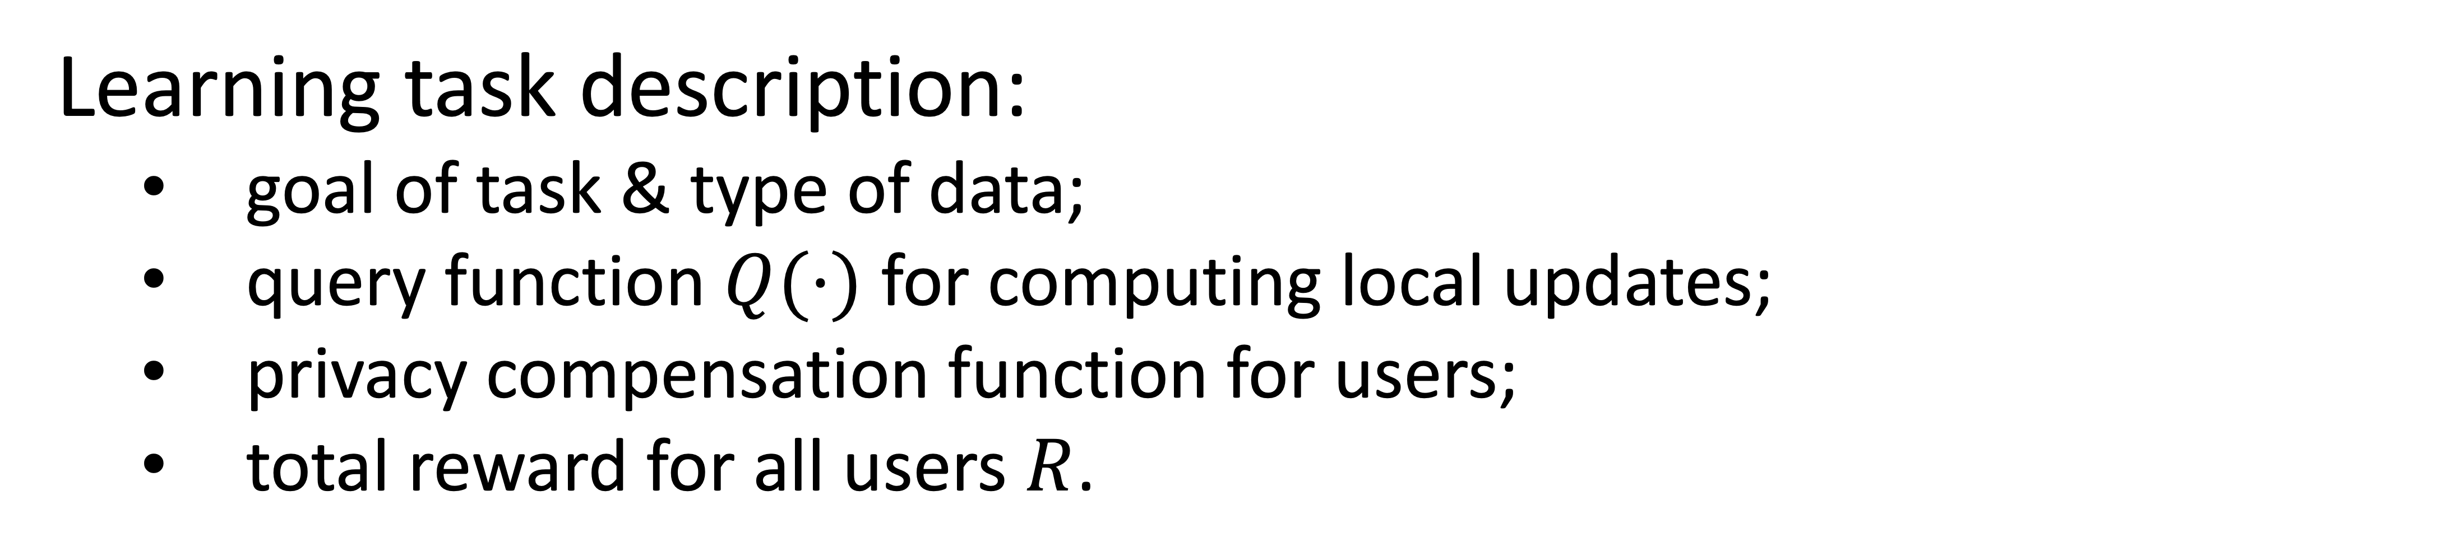
Data trading system for FL
Learning task description:
goal of task & type of data;
query function $Q(⋅)$ for computing local updates;
privacy compensation function for users;
total reward for all users $R$.
Notes:
We first propose a data trading system for federated learning tasks. During the data trading process, at first, the server needs to broadcast the learning task description to all users that are interested in trading their data. The learning task description should include the goal of task and the type of data, e.g., classify animal images, the query function that specify how to query the local dataset, the privacy compensation function that tell users how their rewards are computed, and the total reward the server has.

Slide 8
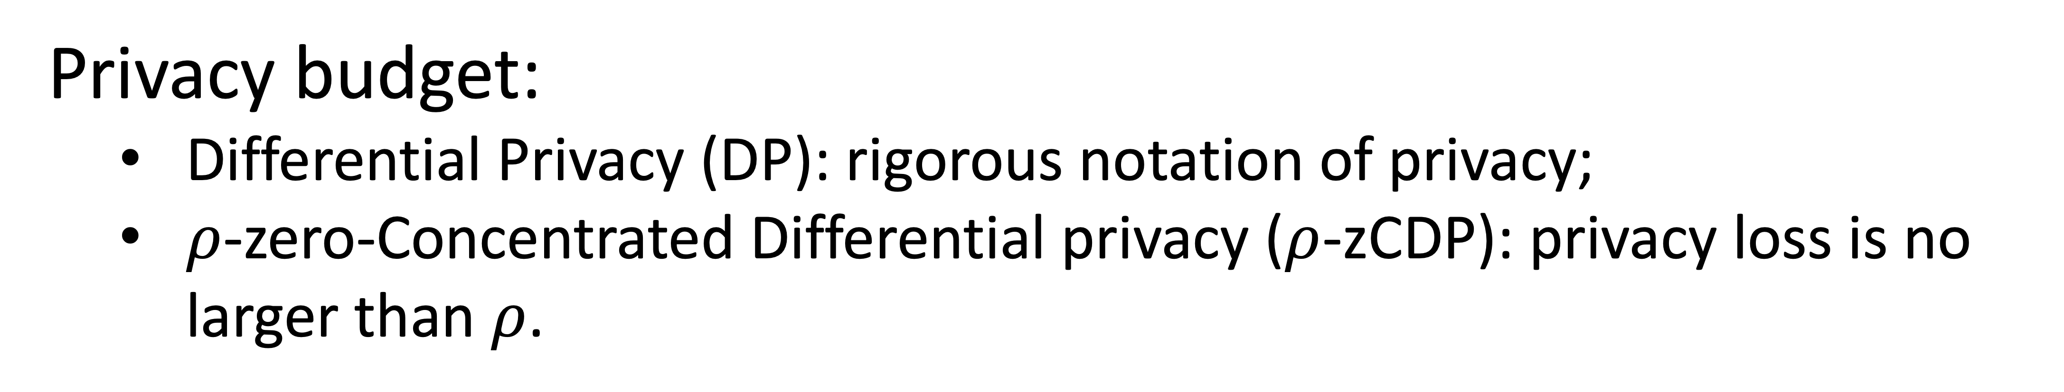
Data trading process in FL systems
Privacy budget:
Differential Privacy (DP): rigorous notation of privacy;
$ρ$-zero-Concentrated Differential privacy ($ρ$-zCDP): privacy loss is no larger than $ρ$.
Notes:
After receiving the learning task description from the server, users will decide whether to participate the task or not. If they are going to participate, they will send their privacy budgets to the server.
Here, we use the notion differential privacy to measure the privacy. Specifically, we use the \rho zero concentrated differential privacy (in short \rho zcdp), and if my privacy budget is \rho, it means that my privacy loss should be no larger than \rho

Slide 9
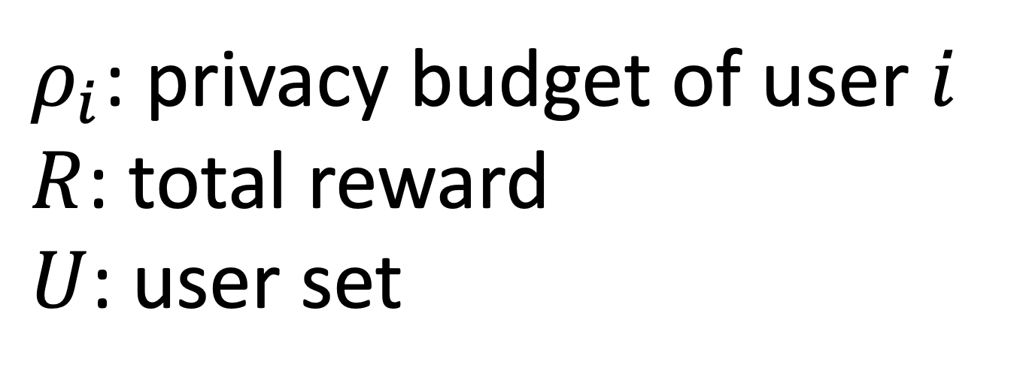
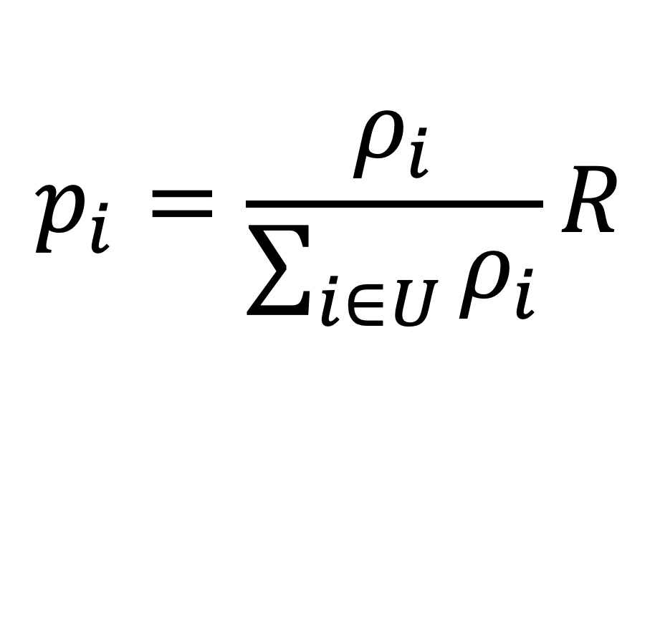
Data trading process in FL systems
Payment:
privacy compensation function:
$$p_{i}=\frac{ρ_{i}}{\sum_{i∈U}{ρ_{i}}}R$$
$ρ_{i}$: privacy budget of user $i$
$R$: total reward
$U$: user set
Notes:
then, the server will pay users according to their privacy budget \rho
here, we design the privacy compensation function to satisfy that users with higher privacy budgets will obtain more rewards.

Slide 10
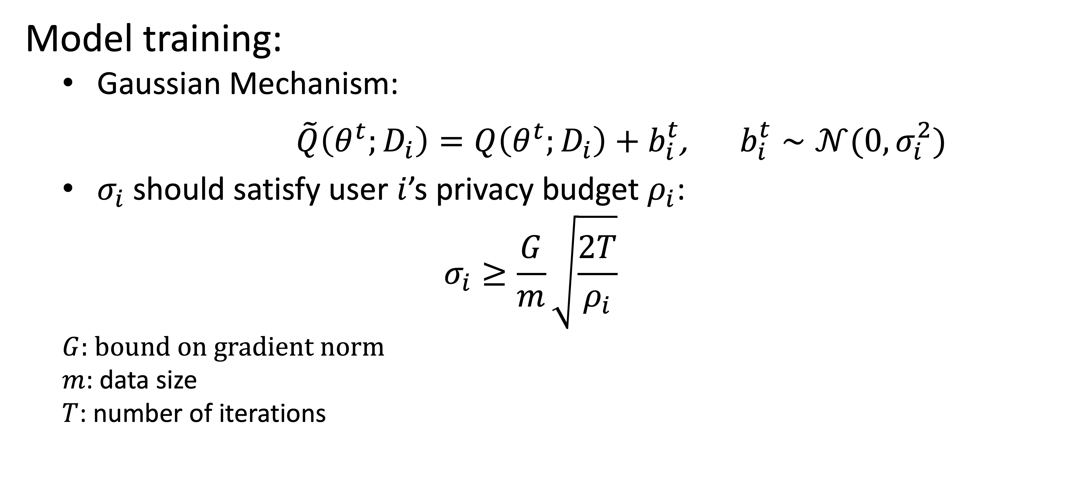
Data trading process in FL systems
Model training:
Gaussian Mechanism:
$\tilde{Q}\left(θ^{t};D_{i}\right)=Q\left(θ^{t};D_{i}\right)+b_{i}^{t}$, $b_{i}^{t}∼𝒩(0, σ_{i}^{2})$
$σ_{i}$should satisfy user $i$’s privacy budget $ρ_{i}$:
$$σ_{i}≥\frac{G}{m}\sqrt{\frac{2T}{ρ_{i}}}$$
$G:$ $bound on gradient norm$
$m$: data size
$T$: number of iterations
Notes:
after receiving the payment from the server, participants start the model training process as we mentioned at the beginning.
but here, the training process should be conducted under each user's privacy budget.
to do so, we use the Gaussian mechanism which can make sure that after the training, the privacy loss of each user will not exceed its privacy budget.
the Gaussian mechanism perturbs the query result by adding Gaussian noise. and the magnitude of the noise sigma_i is chosen to satisfy user i's privacy budget rho_i
we theoritically proved that by doing so, the privacy loss of each user will be no larger than its privacy budget.
In this data trading process, it's nature that everyone wants to maximize its utility, including the server. so then we study how to maximize users/servers utilities.

Slide 11
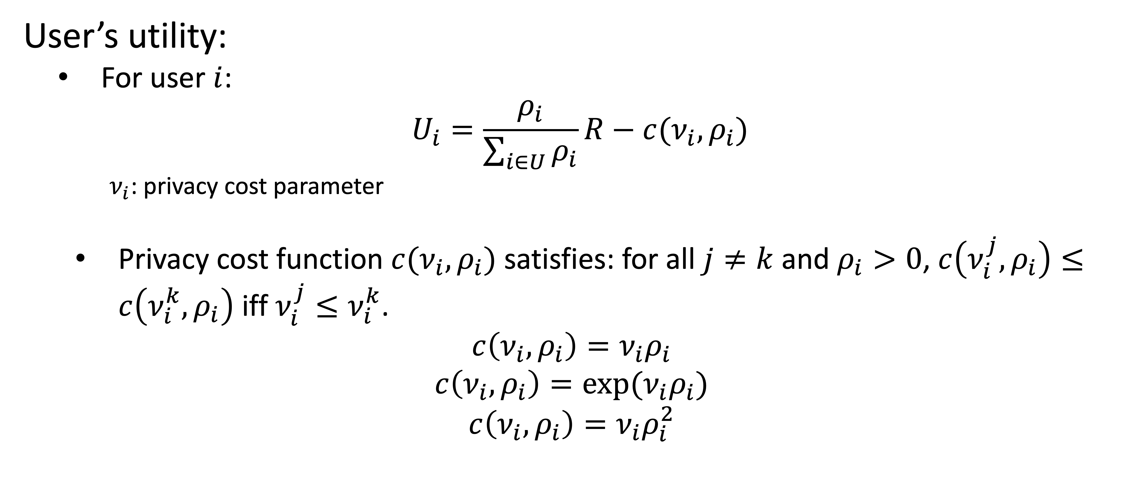
How to maximize users/server’s utilities?
User’s utility:
For user $i$:
$$U_{i}=\frac{ρ_{i}}{\sum_{i∈U}{ρ_{i}}}R−c(ν_{i}, ρ_{i})$$
$ν_{i}$: privacy cost parameter
Privacy cost function $c(ν_{i}, ρ_{i})$ satisfies: for all $j≠k$ and $ρ_{i}>0$, $c\left(ν_{i}^{j}, ρ_{i}\right)≤c\left(ν_{i}^{k}, ρ_{i}\right)$ iff $ν_{i}^{j}≤ν_{i}^{k}$.
$$c\left(ν_{i}, ρ_{i}\right)=ν_{i}ρ_{i}$$
$$c\left(ν_{i}, ρ_{i}\right)={exp⁡(ν}_{i}ρ_{i})$$
$$c\left(ν_{i}, ρ_{i}\right)=ν_{i}ρ_{i}^{2}$$
(reward – privacy cost)
Notes:
we first formulate the utility of users and the server. for the users, it should be its reward minus privacy cost.
here the privacy cost function c measures user's cost on privacy, v_i is the parameter that represents the value of privacy for user i
the privacy cost function should admit a total ordering independently of $\rho_i$.
the following linear, exponential and quadratic functions all satisfy this requirement

Slide 12
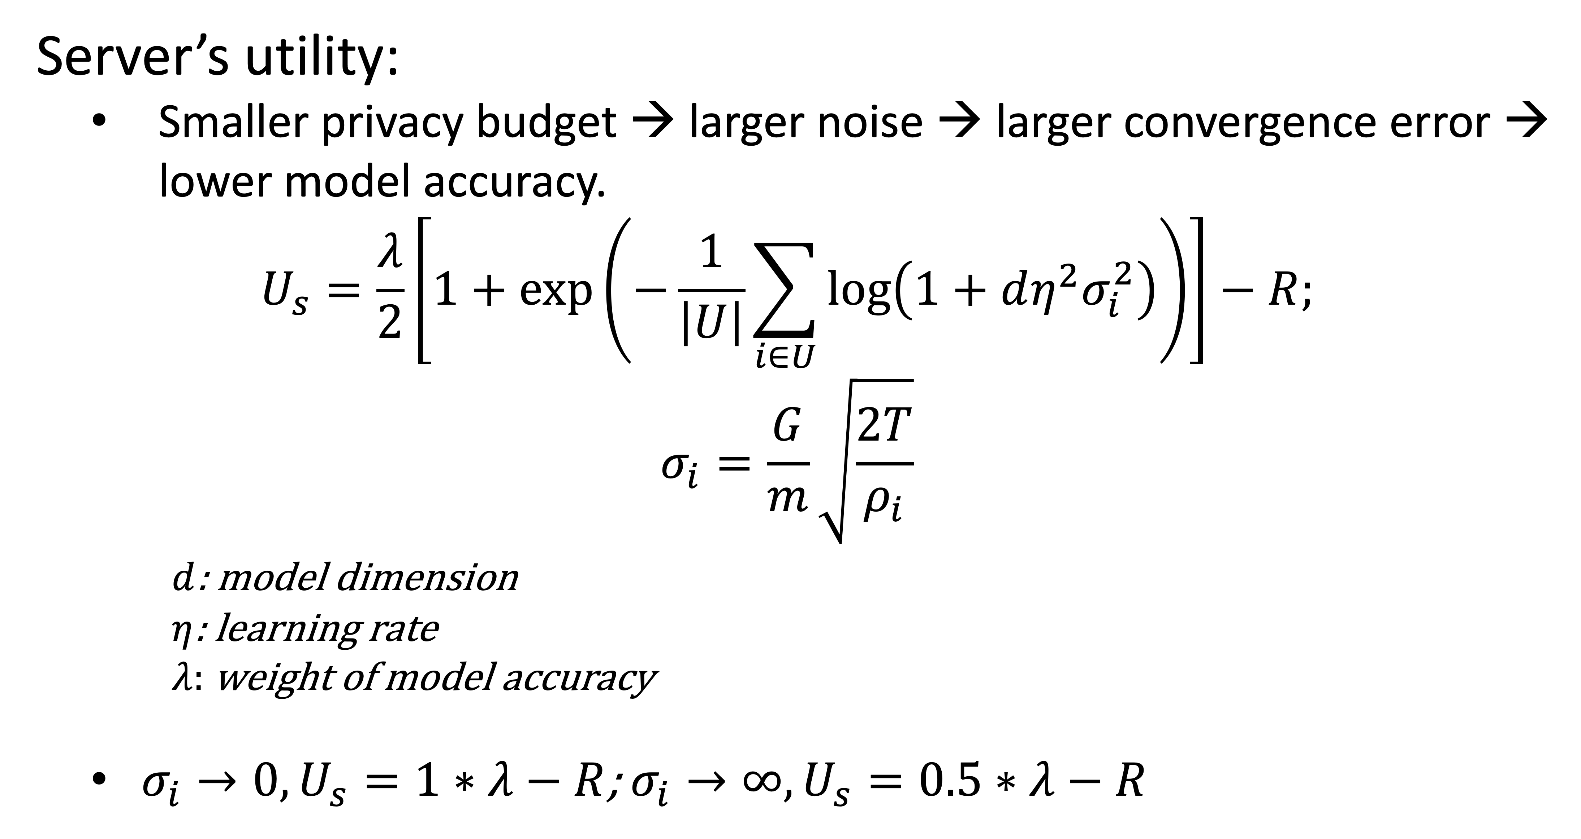
How to maximize users/server’s utilities?
Server’s utility:
Smaller privacy budget → larger noise → larger convergence error → lower model accuracy.
$$U_{s}=\frac{λ}{2}\left[1+\exp\left(−\frac{1}{\left|U\right|}\sum_{i∈U}{\log\left(1+dη^{2}σ_{i}^{2}\right)}\right)\right]−R;$$
$$σ_{i}=\frac{G}{m}\sqrt{\frac{2T}{ρ_{i}}}$$
$d$: model dimension
$η$: learning rate
$λ:$ weight of model accuracy
$σ_{i}→0, U_{s}=1∗λ−R$; $σ_{i}→∞, U_{s}=0.5∗λ−R$
Notes:
for the server, we need to model its gain from the trained model, i.e., model accuracy.
here, we want to emphasize the contribution of users on model accuracy. if the user has small privacy budget, which means large gaussian noise and large convergence error, then the model accuracy will be low.
in server's utility function, the first term represents the model accuracy where lambda is weight for model accuracy.
If the Gaussian noise magnitude is zero, i.e., no noise is added to the local query result, the model will achieve the highest accuracy approaching 1. As the magnitude of the Gaussian noise increases, the accuracy will drop to 0.5, which is the probability of random guess.

Slide 13
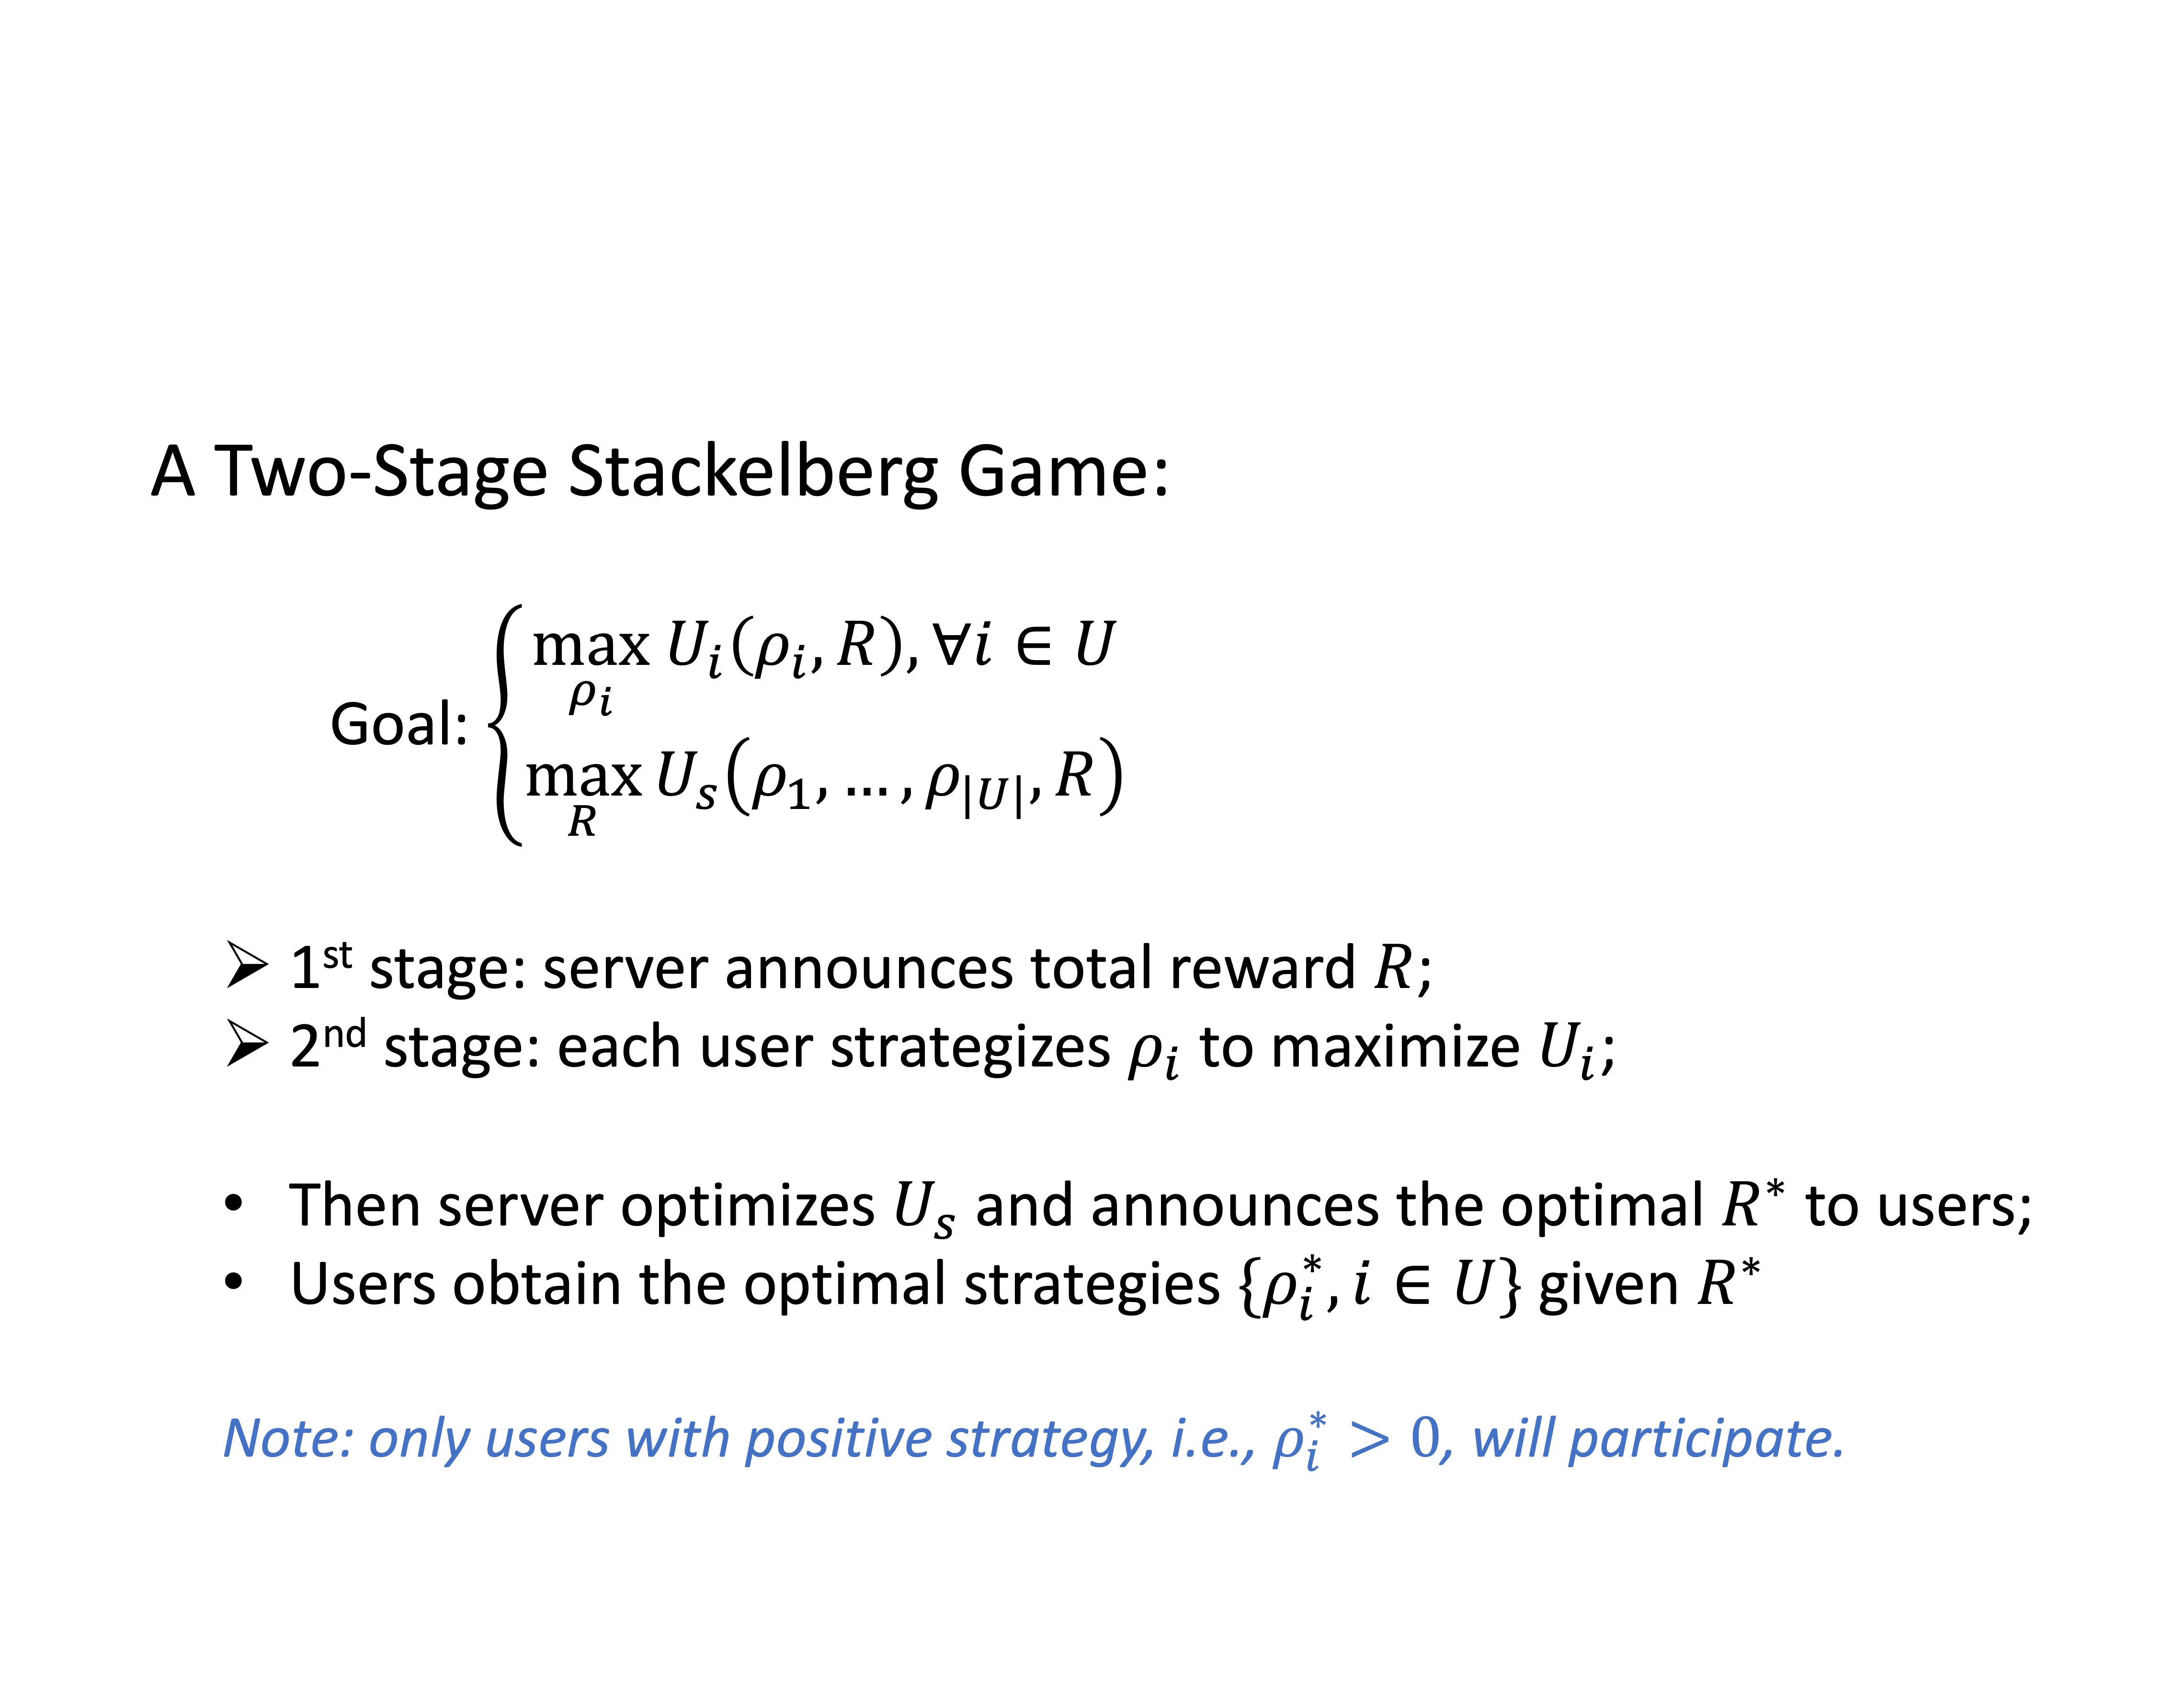
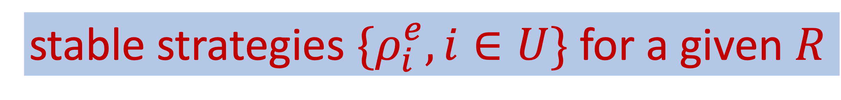
How to maximize users/server’s utilities?
A Two-Stage Stackelberg Game:
Goal: $\left\{\begin{aligned}\max_{ρ_{i}} U_{i}\left(ρ_{i}, R\right), ∀i∈U \\ \max_{R}{U_{s}\left(ρ_{1},…, ρ_{|U|}, R\right)}\end{aligned}\right.$
1st stage: server announces total reward $R$;
2nd stage: each user strategizes $ρ_{i}$ to maximize $U_{i}$;
Then server optimizes $U_{s}$ and announces the optimal $R^{∗}$ to users;
Users obtain the optimal strategies ${\{ρ}_{i}^{∗},i∈U\}$ given $R^{∗}$
Note: only users with positive strategy, i.e., $ρ_{i}^{∗}>0$, will participate.
stable strategies ${\{ρ}_{i}^{e},i∈U\}$ for a given $R$
non-cooperative game
Notes:
now we have utilities of users and the server.
for user i it wants to have the best strategy on privacy budget that maximize Ui
for the server, it wants to get the best strategy on the total reward that maximize Us
we solve this problem using a two-stage stackelberg game.
at the first stage, server anounces a total reward R to all users.
then at the second stage, each user strategizes its privacy budget to maximize its utility.
note that the second stage is a non-cooperative game which will generate stable strategies for all users given a R
the server knows that there always exists a stable stragies for users, which is a function of R. Then it uses this stable stragies to compute the optimal total reward and anounces to users, so that users can compute their optimal privacy budget.
note that only users with positive strategies with participate the task.

Slide 14
Evaluation
Impact of # of users: $\left|U\right|∈[100, 1000]$
Notes:
We simulate the Two-Stage Stackelberg Game process to maximize the utilities of users and server under various system settings. Specifically, we first observe the results under different number of users, ranging from 100 to 1000. as we mentioned, only users with positive privacy budgets will participate the task, we can see that as the number of users interested in the task increases, the number of participants increases. also, the utility of server will increase, and , It’s expected to see that this trend will diminish.

Slide 15
Evaluation
Impact of # of users: $\left|U\right|∈[100, 1000]$
Notes:
For the utility of users, we report the average value and the corresponding variance. We can see that users’ utilities will decrease on average and become less diverge due to greater competition.

Slide 16
Evaluation
Impact of privacy value $ν_{i}∈uniform(1, ν_{max})$: $ν_{max}∈[2, 10]$
Notes:
Then, we observe the results under different settings of privacy values.
Actually, we assume that each privacy value is sampled uniformly from 1 to \nu_max.
As the range of privacy values increases, the number of participates and utility of server decrease as the privacy becomes more expensive.

Slide 17
Evaluation
Impact of privacy value $ν_{i}∈uniform(1, ν_{max})$: $ν_{max}∈[2, 10]$
Notes:
In return, the utility of users increase on average and become more diverge.

Slide 18
Thank you!

Slide 19
Takeaways
Data trading systems that motivate users to contribute their data promote machine learning deployments on sensitive data.
Using FL saves privacy loss of users by nature but still has privacy leakage.
Using the concept of DP, the privacy loss of users can be measured and converted into monetary rewards.

Slide 20
Huge volumes of data born at the edge…
Billions of phones & IoT devices constantly generate data
20
Notes:
In the recent years, we see an increasing number of smart devices, like smart phones, smart watches, come out and interact with our daily life.
And everyday these smart devices constantly generate a huge volumes of data…
And we all know that these data are precious because nowadays machine learning techniques enable us to leverage these data to provide better products and smarter services.
While in practice, how do we use these data with machine learning techniques? Or How to learn from the data that is born at the edge?

Slide 21
Gather data in the cloud?
Private data publishing
smaller privacy loss
high computation cost
prediction
model
Sanitize data
Training data
Notes:
Will, to mitigate the latency in the inference phase, we can move the inference to the device. Which means, we still gather the data and train the model in the cloud. But then, the cloud server sends the trained model to the device so that the inference can be done on device.
But, the privacy loss is still high.

